Slide 1
Friday, August 24, 2012
TISK Problems
Draw a scatter plot for the data set shown then determine if there is a correlation.
State the constant difference: -5, -3, -1, 13, 51, 125, 247
Tell which difference was constant in problem #2.
Hours of Studying | Hours of Exercise
7.5 | 6
10 | 9
5 | 3
9 | 9
3.75 | 10
5.2 | 5
We will have 3 Mental Math Questions today.
HOMEWORK: p. 78 #30-38 even, 40-43 all, 57-63all, & 65 OPTIONAL: Review Chapter 2 Lessons 1-4 in Algebra textbook using p. 106-107 #1-39
Notes:
Start with the square of 5. Add 27. Subtract 19. Divide by 3. (11)
Start with the square of 6. Add 27. Subtract 19. Divide by 4. (11)
Start with the square of 7. Add 27. Subtract 19. Divide by 3. (19)

Slide 2

Homework Check
36) -58
38) 10
40) -32.45
42) -0.662
44) $−\frac{3}{5}$
46) $−\frac{5}{6}$
48) 8
50) 5
52) 7
54) 7
56) 5
58) 24
65) a. 2, 5, 8 b. 0, -15, -30
c. 10, 15, 19
66) There were 13 cases of juice used during lunch.

Slide 3
Multiplying & Dividing Integers
4
·
5
of 5 each
4 groups
= 20

Slide 4
-
4
·
5
of 5 each
the opposite of 4 groups
= -20

Slide 5
-
4
·
5
of -5 each
4 groups
= -20

Slide 6
-
-
4
·
5
of -5 each
the opposite of 4 groups
= 20

Slide 7
So what could the rule be?
4·5 = 20
-4 · 5 = -20
4 · (-5) = -20
-4 · (-5) = 20
Multiply the numbers.
If there are an even number of (-) signs, the answer is (+).
If there are an odd number of (-) signs, the answer is (-).

Slide 8
Check Points.
-8(5) = _____
-2(-3)(-7) = _____
-16(-3) = _____
-9(-5)(-2)(-10) = _____
-12(-19) = _____
-72(2) = _____
5(7)(-3) = _____
2(3)(4)(5)(-1) = _____
3(-4)(3)(-4) = _____
(-1)(-1)(-1)(-1)(-1)(-1)(-1)(-1) = ___

Slide 9
What about Division?
Same rules!
Divide.
Even number of (-) signs = (+) answer
Odd number of (-) signs = (-) answer

Slide 10
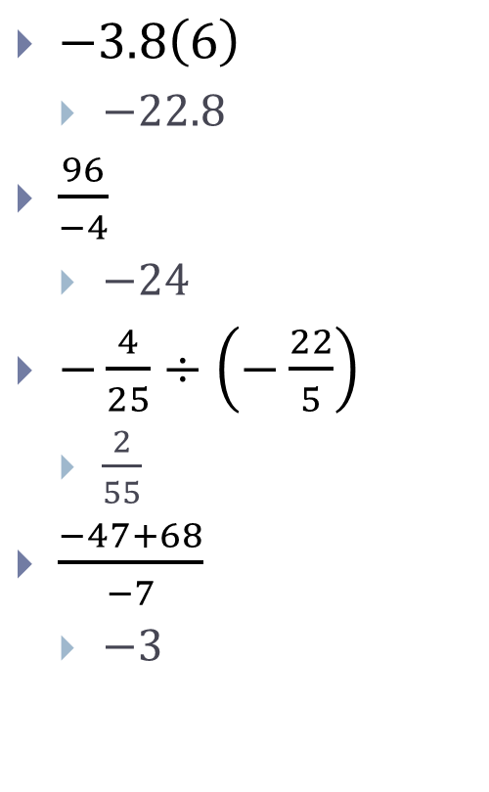

Evaluate.
$−\frac{2}{3}\left(\frac{5}{4}\right)$
$−\frac{5}{6}$
$−\frac{18}{−6}$
3
$\frac{3}{7}÷\left(−\frac{6}{14}\right)$
$−1$
$\frac{−40+4}{−9}$
4
$−3.8\left(6\right)$
$−22.8$
$\frac{96}{−4}$
$−24$
$−\frac{4}{25}÷\left(−\frac{22}{5}\right)$
$\frac{2}{55}$
$\frac{−47+68}{−7}$
$−3$

